Slide 1
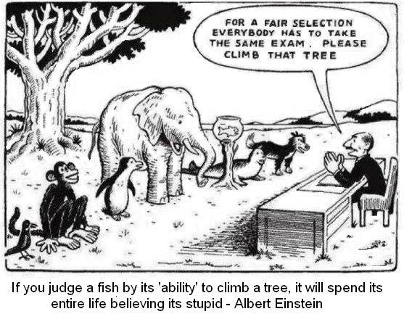

Slide 2
What remains with our graduates?
Education is what remains after one has forgotten what one has learned in the school.
~Albert Einstein~

Slide 3
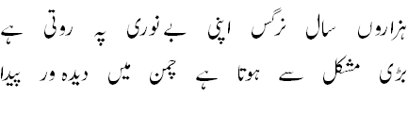
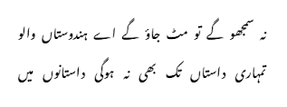

Slide 4
What should remain with our graduates?
Probably;
Habits of being thoughtful—most of the time
Scientific in their temperament and process of inquiry
Sincerity and creativity in their efforts

Slide 5


The problem begins with…how to do it?

Slide 6

A thoughtful “copy-paste” to cheat turnitin!!!

Slide 7

…and finally, as a teacher,…DIY

Slide 8
I hope…
None of us like to be “Y” of “DIY”

Slide 9
What should remain with our graduates?
Probably;
Habits of being thoughtful—most of the time
Scientific in their temperament and process of inquiry
Sincerity and creativity in their efforts

Slide 10
Stage-1: Aptitude evaluation
Setting program entry requirements or assessment of enrolled students
A zero semester would be of ample help. Alternatively, unlike NTS tests, an entrance exam/survey/activities may be designed that reflect participants’ intellect, knowledge and motivations.
Outcome: By the end of this stage, a rudimentary map of students’ capabilities should be drawn. On the basis of these maps (strengths and weaknesses) individuals should be advised on what they may follow (in terms of program, specialization etc).

Slide 11
Stage-2: Foundation revisit
Should focus on development of physical understanding of laws formulated by basic sciences (By physical understanding I mean, utterly unmathematical and imprecise visualization).
It should essentially include Philosophy of science and Philosophy of engineering.
Outcome: Students should be able to understand natural laws, map them to everyday scenarios and describe/elaborate them fluently.

Slide 12
Stage-3: Experimental Design & Mathematical Skills
Development of experimental design skills -- to verify physical understanding and
Development of mathematical skills (let it make sense)-- to analyze and describe the outcomes obtained in the previous phase.
Introduce computer as a tool which eases the computation.
Outcome: Students should be able to translate everyday observations to logically hypothesize the experiment design and experimental outcomes to mathematical entities (expressions, functions, equations etc.)

Slide 13
Stage-4, 5: Dedicated to programs’ fundamental/core
These must be offered ensuring that all the previous knowledge acquired in stage 2 and 3 are carefully employed while delivering contents e.g., “Maxwell Equations” studied under Physical Sciences in stage-2/3 must be the starting point of “circuit theory”.
Programming shouldn’t start with “hello world”; there may be more sensible and meaningful ways to introduce it to the students e.g., physical/mathematical problems (stage 4, 5) become increasingly complex to solve manually and repeatedly… etc.

Slide 14
Stage 6, 7: Applying the knowledge: a project driven approach
A project running throughout this year…aided by advance courses if needed.
The project should be vigilantly devised such that it maximizes the utilization of subjects already taught or being-taught.
The project may be divided into 4 quarters
In the first quarter, students may be put to work on individual basis
In second quarter, multiple student (group) combine their work
In third quarter, whole class combine their work.
The final quarter should be dedicated to final write up, reporting, etc.
Here the students should be able to demonstrate individual/group work capabilities, pass on own work, take up others work, improvisation and management.

Slide 15
Stage 8, 9: Specialization, FYP

Slide 16
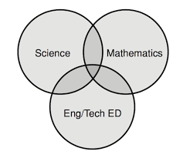
Speaking of subjects

